Slide 1
Gavi 6.0: Évolution des Partenariats de l’Alliance
Consultations par pays
Septembre 2024

Slide 2





Alliance model | Gavi is a public-private partnership to improve immunisation outcomes
Implementing country governments
Global and local Civil Society Organisations (CSOs)
Donor country governments
Vaccine manufacturers
Research agencies and technical health institutes
Global and local private sector partners

Slide 3
Alliance model | We partner to deliver Gavi’s strategic goals
 | Partners contributions
 | Advocacy | Financing mechanisms | Procurement | Capacity building | Risk monitoring | Knowledge product | Immunisation delivery | Innovation
1. Introduce and scale up vaccines | ✓ (for supporting raise awareness of immunisation agenda) | ✓ (supporting countries finance RI vaccines, global vaccine stockpiles and surveillance) | ✓ (pooled procurement of vaccines, including through COVAX, and diagnostics) | ✓ (technical assistance for public immunisation programme design and execution) | ✓ (oversee vaccine introduction programs) | ✓ (prioritisation and optimisation guidance; immunisation programmes evaluations) | (vaccines provision and strengthening of immunisation services) | ✗
2. Strengthen health systems to increase equity in immunisation | ✓ (for promoting increased equity of immunisation programmes) | ✓ (supporting channelling of funds to strengthen health systems) | ✓ (procurement of products to support enhance equity, e.g., cold-chain equipment to reach remote communities) | ✓ (technical assistance for public immunisation programme delivery) | ✓ (oversee programs such as the Big Catch Up) | ✓ (develop and disseminate global goods supporting increase equity, e.g., immunisation program evaluations) | ✓ (addressing drivers of demand - e.g., gender barrier - and supply - e.g., stock management, healthcare worker capacity, delivery in fragile settings/ to ZD and un/under immunised incl. through community engagement) | ✓ (immunisation delivery products)
3. Improve financial sustainability of immunisation programmes | ✓ (for promoting sustainable immunisation funding) | ✓ (promote prioritisation of and domestic public financing to ensure sustainable immunisation programmes e.g., through Financing Accelerator) | ✗ | ✓ (support for public management of Gavi resources, incl. to prepare for transition) | ✗ | ✗ | ✗ | ✓ (accelerate use of innovative financing instruments)
4. Ensure healthy markets for vaccines and related products | ✓ (for improving supply security ( inc. encouraging regional manufacturing diversification), and maintaining vaccine affordability) | ✓ (downstream “pull” financial instrument, directed at African manufacturers (AVMA)) | ✓ (procure immunisation-related products, focusing on reliable, consistent and affordable supply) | ✗ | ✗ | ✗ | ✗ | ✓ (promote transformational innovations across immunisation products, services and practices)
Collaboration
Main source: Gavi 5.0 strategy, as approved by the Board in June 2019, see here and Gavi 5.1 strategy as approved by the Board in December 2022, see here and here for deep-dive on regional manufacturing..
Notes:
Given above objectives / implications, what is our level of ambition in Gavi 6.0 against key parameters e.g., on membership, R&R, accountability, PEF structure etc.

Slide 4
Alliance model | Several levers support partners to deliver Gavi strategic goals
5.0/5.1 funding¹
Description
Partner contributions
Partnership Engagement Framework
$0.9n²
Provide technical assistance through partners (see next slide)
Advocacy, financing mechanisms, capacity building, global goods immunization delivery, innovation
Cash grants
$ 2.8bn
Provide cash to support a new vaccine introduction or campaign, strengthen health systems, improve equitable reach of immunisation³
Capacity building, immunization delivery, innovation
Gavi funding levers
Vaccines procurement
$ 5.8bn
Support governments by procuring vaccines or supporting financing of vaccines
Procurement; financing mechanisms
Advocacy
-
Advance social and political will for immunisation outcome
Advocacy
Note: 10% of funding across HSS, EAF, and PEF TCA is ringfenced for CSOs at the country level

Slide 5

Gavi 6.0 Strategy ‘one-pager’ - simplified
Gavi 6.0 strategy one-pager (2026 – 2030)
VISION
Leaving no one behind with immunisation
MISSION
To save lives and protect people’s health by increasing equitable and sustainable use of vaccines
Country-led, sustainable
Community-owned, inclusive
Zero-dose and missed communities, first priority
Gender-focused
Differentiated, fragile-responsive
Integrated
Adaptive, resilient
Climate-sensitive
Innovative
Collaborative, accountable
PRINCIPLES
1
INTRODUCE AND SCALE UP VACCINES
2
STRENGTHEN HEALTH SYSTEMS TO INCREASE EQUITY IN IMMUNISATION
3
IMPROVE PROGRAMMATIC AND FINANCIAL SUSTAINABILITY OF IMMUNISATION PROGRAMMES
4
ENSURE HEALTHY MARKETS FOR VACCINES AND RELATED PRODUCTS
GOALS
GOALS
Long-term predictable funding
One Alliance
Global political commitment
Simple, efficient and agile Gavi operating model
Digitalisation, improved data and evidence
Collaboration with private sector and development finance institutions
ENABLERS

Slide 6
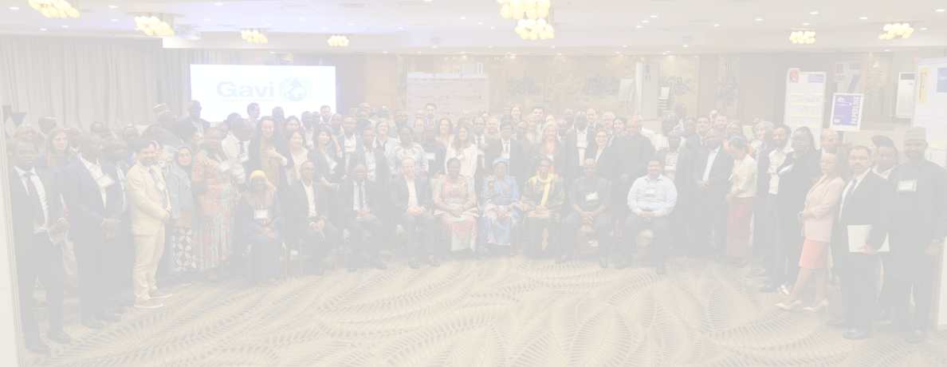
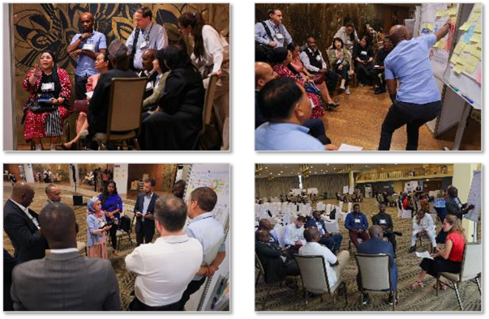



A country-centric, consultative design process, putting country voices at its heart
Interviews, focus groups with ~50+ countries / 100+ stakeholders at political and technical levels
2-day workshop in Togo (February 2024) >120 in-country & partner representatives
Web survey completed by ~1050 country ministry staff, CSOs, Alliance and expanded partners
Notes:
The journey to design Gavi 6.0 started over a year ago and has been informed by extensive consultations with a broad range of stakeholders to ensure the strategy we designed meets country needs.
This consultative process included:
Gathering inputs from ~1050 country ministry staff, CSOs, Alliance and expanded partners through a web survey
Conducting interviews with more than 50 countries and over 100 stakeholders
With efforts culminating at an important workshop in Togo, gathering over 120 in-country representatives to hear their perspectives on the 6.0 priorities under consideration
Country voices have truly been at the heart of Gavi design process, and we are very grateful for the time and inputs partners shared with us along the journey.

Slide 7
Approach to operationalise Gavi 6.0
Strategy / design finalization
Focus of our consultations and redesign
Policy
Development of Gavi 6.0 theory of change and measurement framework
Finalisation of key sub-strategies, to include: Health Systems Strategy New approach to Fragile, Conflict & Humanitarian settings Market shaping strategy
Implementation
Updates of Gavi’s programmatic policies (Funding Policy Review), to include: Eligibility and Transition Policies (incl. MICs) Co-financing Policy Health Systems and Immunisation Strengthening (HSIS) Policy Donation Policy Vaccine prioritisation & optimisation
1
3
Evolution of the Alliance partnership approach: Update the partnership model, redesign PEF, standardize and simplify grant processes Increase collaboration with GHIs / Lusaka agenda
Update of Secretariat operating model, (incl. through operational excellence agenda): Rollout Evolve Review business partnering in programmes team to foster closer collaboration and alignment to serve countries Continue optimise internal resource allocation Update of vaccine & programme funding guidelines Reprogram HSS-like support in line with 6.0 objectives
4
2
5

Slide 8
Scope of work | High-level approach for area 4
4
Evolution of the Alliance and partnership model
Deliverable | Objectives & key components | Milestones | Lead or WG
Evolution of the Gavi partnership | Update partnerships model by reviewing country level implementation successes / challenges to identify key shifts needed in 6.0 including: Update Alliance Partnership structure that is reflective of current Partnership Ecosystem Develop mechanisms to support new regional partnerships e.g., ACDC/AU and continue localisation agenda Consolidate and accelerate CSO engagements (leveraging ongoing work of CSCE SI)* and faith based organisations Redesign PEF focusing on revised partnership principles, updated scope of work as per 6.0 priorities and allocate funding for country, regional and global partners, refresh accountability/performance mechanisms Standardise and simplify grants processes for partners – application, contracting, disbursements and reporting – EVOLVE rollout | June 2024: initial discussions on PEF structure – e.g., consolidation of PEF TCA (TBC); Foundational TCA, engagement of CSOs H2 2025: Share with PPC as part of update on 6.0 operationalisation | PST (PEF, CSO team leading), Strategy (tbc if co-leading) PPE, HSIS, IF&S, VP, CP F&C, FD&R, Programme Finance, MEL
Increased collaboration with GHIs / Lusaka agenda | Detail scope of work with timelines and deliverables for the 4 workstreams (malaria, HSS, country engagement, enabling functions) Stand up cross-Gavi/GF/GFF Board/Committee Joint Committee Working Group (JCWG) Develop a future state for an updated collaboration model bringing together core aspects of programming, funding, monitoring and operational approaches to be used for TB | June 2024: Finalize TOR for JCWG, align on HSS metrics H2 2024: Develop country-specific roadmaps and begin implementation of country engagement (update Board) H2 2025: Share with PPC as part of update on 6.0 operationalisation | OCEO (leading) HSIS, VP, FD&R, CPD
Ongoing
Ongoing
Notes: (*) PPE will organize regular cross-secretariat meetings on CSO engagement to strengthen visibility; a workshop will be organized after the summer focused on strategy to develop a shared vision on Gavi CSO engagement towards 6.0; PPE will develop channels to share activities with CSOs between meetings.

Slide 9
Unpacking the key priorities | Principles
PRINCIPLES
Gavi 6.0 strategic priorities and shifts
Bolster country leadership to sustainably finance and deliver immunisation
Country-led, sustainable
Community-owned, inclusive
Zero-dose and missed communities, first priority
Gender-focused
Differentiated, fragile-responsive
Integrated
Adaptive, resilient
Climate-sensitive
Innovative
Collaborative, accountable
Engage communities and civil society organisations in planning, implementation and oversight of immunisation
Revamping the Alliance model for fragile, conflict, and humanitarian settings
Build stronger global health security including through outbreak/pandemic response mechanisms and regionally diversified vaccine production
Ensure Gavi’s programmes integrate climate change adaptation and mitigation
Scaling innovation in immunisation, by implementing the Alliance’s innovation approach and accelerating innovative, system-focused financing instruments
Starting the next chapter continuing to build new partnerships including with regional organizations such as the AU / Africa CDC, and other Global Health Institutions in line with the Lusaka Agenda, and streamline the Secretariat operating model

Slide 10
Partnerships Review
1
Review the current partnership model with focus on supporting the needs of countries
2
Co-create partnerships that will drive the attainment of 6.0 strategic goals
3
Assess and realign partner capabilities at country, regional and global level
4
Establish a process to celebrate wins, sharing of promising practices and escalation

Slide 11
Vision: Gavi 6.0 Partnership Framework
Gavi Goals
1
INTRODUCE AND SCALE UP VACCINES
2
STRENGTHEN HEALTH SYSTEMS TO INCREASE EQUITY IN IMMUNISATION
3
IMPROVE PROGRAMMATIC AND FINANCIAL SUSTAINABILITY OF IMMUNISATION PROGRAMMES
4
ENSURE HEALTHY MARKETS FOR VACCINES AND RELATED PRODUCTS
Results-focused
Improved coordination and management
Driving mutual accountability
Openness and transparency
Partnership Outcomes
Results-driven implementation and simplified performance monitoring that generates actionable insights and drives evidence-based decision-making
Strengths and capabilities of each partner appropriately leveraged to efficiently respond to the needs of country governments as “One Alliance” and achieve our shared mission
Institutionalized mechanisms to foster mutual accountability across the alliance partners and support optimal implementation of country EPI priorities
Collaborative processes to ensure consistent and transparent engagement of Alliance partners, and in planning, decision-making, policy development and resource allocation
Target Operating Model
Goal-oriented partnerships
One country, One TA plan
Country-led, needs-based TA investments
Capability-based roles and responsibilities
Clearly defined incentives and KPIs
Proactive communication to external parties
Core principles
Shared purpose and positive intention
Respect and trust
Impact and accountability
Adaptive and learning mindset
Partnership Foundation
Instruments & Tools
Long-term funding
Partner Engagement Framework
Grant Agreements
Service Agreements
CSO Fund Manager

Slide 12
Proposition: Key shifts to design the future
FROM
TO
Weak partner performance monitoring (activity-focused, not results-driven)
Limited understanding of Gavi’s priorities and processes
Capacity and resource constraints
Results focused
Results-driven implementation and simplified performance monitoring that generates actionable insights and drives evidence-based decision-making
Complex governance and contracting structure
Fragmented efforts at country level
Capacity and resource constraints
Unclear division of labour, R&Rs, and low visibility across partners
Improved coordination and engagement
Strengths and capabilities of each partner appropriately leveraged to efficiently respond to the needs of country governments as “One Alliance” and achieve our shared mission
Inconsistent accountability mechanisms
Dual role of core partners who serve as overseers and recipients of Gavi funds
Driving mutual accountability
Institutionalized mechanisms to foster mutual accountability across the alliance partners and support optimal implementation of country EPI priorities
Inconsistent and opaque communication channels
Inconsistent consultation and involvement of partners and countries in decision-making
Insufficient capacity and resourcing (across partners)
Openness and transparency
Collaborative processes to ensure consistent and transparent engagement of Alliance partners, and in planning, decision-making, policy development and resource allocation

Slide 13
Timelines for the Redesign Process
Alliance Partnership model will undergo a redesign in the coming year. PST will lead the process, in collaboration with a Secretariat working group, partners and countries
2024
2025
June
ALG Meeting
September
Core Partner Retreat
October
APPT
December
Gavi Board
March
APPT
April
Board Retreat
June
Board Meeting
Key deliverables
Cross alliance coordination working group formed
Consultations at country, regional, global level finalized on the partnership model
By December, a draft first concept on the partnership model
Key deliverables
Draft partnership model shared with APPT in March (for guidance)
Draft Final Partnership Model shared with APPT (for approval)
Partnership model published and socialized with Alliance stakeholders
Notes:
Multiple rounds of consultations with key stakeholders, both internal and external to the Secretariat, are planned. These are documented in the draft detailed workplan.
Efforts are underway to leverage opportunities to integrate consultations in the upcoming partner and country meetings (e.g., EPI managers meeting, Partner retreats)

Slide 14
6 | Questions/ Discussion
1
Comment pensez vous que les partenariats de Gavi peuvent contribuer à la réalisation des objectifs stratégiques de Gavi ?
2
Quels sont les éléments du modèle de partenariat qui sont efficaces et qui devraient être maintenus ?
3
Dans quels domaines devons-nous faire plus / différemment / mieux pour mettre en œuvre la stratégie 6.0 ?
4
Qui sont les acteurs et intervenants qui devraient être impliqués dans la création du futur modèle de partenariat ?

Slide 15
Merci

Slide 16
6 | Key Questions For Discussion
1
What is your vision for how Gavi Alliance partnerships may best contribute to achieving each of Gavi’s strategic goals?​
Which elements of the partnership model are effective and should be maintained without changes?​
2
Where do we need to do more / differently / better as a partnership to deliver on 6.0 strategy?​
3
4
Who are the key stakeholders we need to involve in the creation of the future partnership model?

